Slide 1
Discrete Mathematics (CSC 1204)
2.2 Set Operations

Slide 2
Set Operations
Union ( ∪ )
Intersection ( ∩ )
Disjoint
Difference (“ − ”)
Complement(“‾ ”)
Symmetric Difference ( ⊕ )

Slide 3
Union of Sets
Definition: Let A and B be sets. The union of the sets A and B, denoted by A U B, is the set that contains those elements that are either in A or in B, or in both.
An element x belongs to the union of the sets A and B if and only if x belongs to A or x belong to B
A∪B = { x | x∈A ∨ x∈B }
A∪B is pronounced as “A union B”
Example 1: The union of the sets {1, 3, 5} and {1, 2, 3} is the set {1, 2, 3, 5}; that is, {1,3, 5} U {1, 2, 3} = {1, 2, 3, 5}
Example 2: If A = {Cyndi, Faisal, Abdullah}, and B ={Laila, Rahim}, then, A ∪ B = {Cyndi, Faisal, Abdullah, Laila, Rahim}

Slide 4
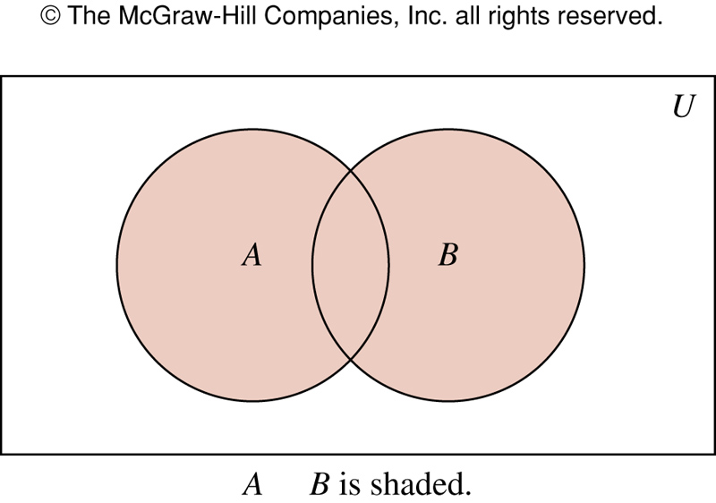
FIGURE 1 Venn Diagram Representing the Union of A and B.
∪

Slide 5
Intersection of Sets
Definition : Let A and B be sets. The intersection of the sets A and B, denoted by A∩B, is the set containing those elements in both A and B.
An element x belongs to the intersection of the sets A and B if and only if x belongs to A and x belongs to B
A ∩ B= { x | x ∈ A ∧ x ∈ B}
Example 3: The intersection of the sets {1, 3, 5} and
{1, 2, 3} is the set {1, 3}; that is, {1,3, 5} ∩ {1, 2, 3} = {1, 3}
Example 4: If A = {x : x is a Bangladeshi president}, and
B = {x : x is deceased}, then
A ∩ B = {x : x is a deceased Bangladeshi president}

Slide 6
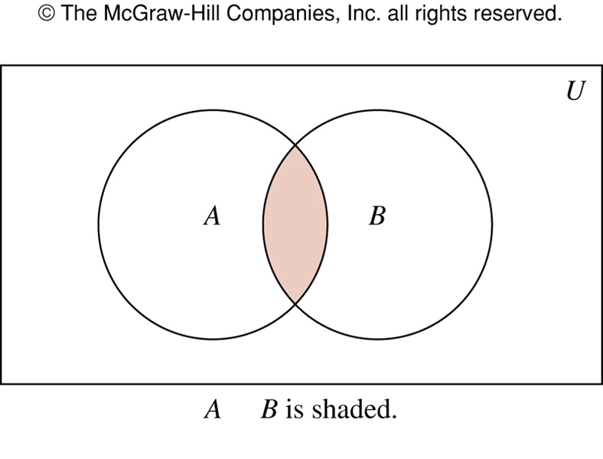
FIGURE 2 Venn Diagram Representing the Intersection of A and B.
∩

Slide 7
Disjoint Sets
Definition : Two sets are disjoint if their intersection is the empty set.
Let A and B be sets. If A ∩ B = ∅ , that is if A and B do not have any element(s) in common, then A and B are said to be disjoint or non-intersecting.
Disjoint ==> Non-intersecting
Example 5: Let A= {1, 3, 5, 7, 9} and B={2, 4, 6, 8, 10}. Because A ∩ B = ∅, A and B are disjoint.

Slide 8
Venn Diagram showing Disjoint of the two sets A and B
U
B
A

Slide 9
Principle of inclusion-exclusion
Question: What is the cardinality of a union of two sets A and B?
Answer:
|A∪B| = |A| + |B| - | A ∩ B |
The generalization of this result to unions of an arbitrary number of sets is called the Principle of inclusion-exclusion

Slide 10
Difference of Two Sets
Definition : The difference of the sets A and B, denoted by A – B, is the set containing those elements that are in A but not in B.
An element x belongs to the difference of A and B if and only if x∈A and x∉B. This tell us that
A – B = { x| x∈A ∧ x∉B }
The difference of A and B is also called the complement of B with respect to A.
A – B = A ∩ B

Slide 11
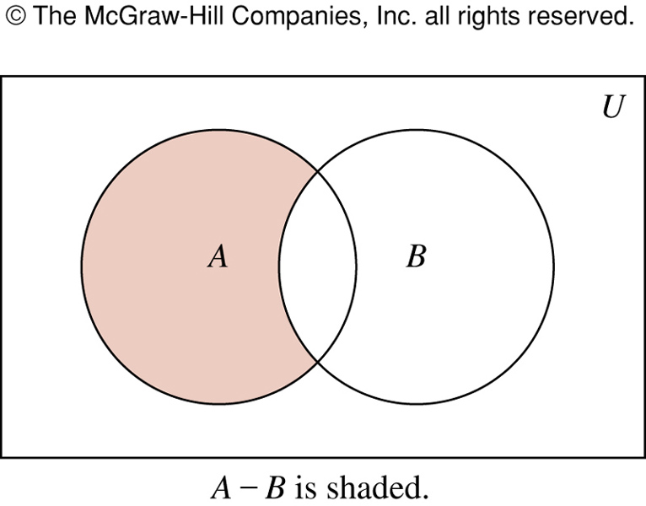
FIGURE 3 Venn Diagram for the Difference of A and B.

Slide 12
Difference of two sets
Example 6: The difference of {1, 3, 5} and
{1, 2, 3} is the set {5}; that is, {1, 3, 5} – {1, 2, 3} = {5}.
Note: This is the different from the difference of
{1, 2, 3} and {1, 3, 5} which is the set {2}.
Example 7: Let A = { a, b, c} and B = { b, c, d, e }.
A – B = { a }
B – A = { d, e }

Slide 13
Complement of a Set
Definition: Let U be the universal set. The complement of the set A, denoted by Ā, is the complement of A with respect to U.
An element x belongs to Ā if and only if x∉A
Ā = { x | x∉A }
In other words, the complement of the set A is U – A,
Ā = U – A
Practice yourself: Example 8 & Example 9

Slide 14
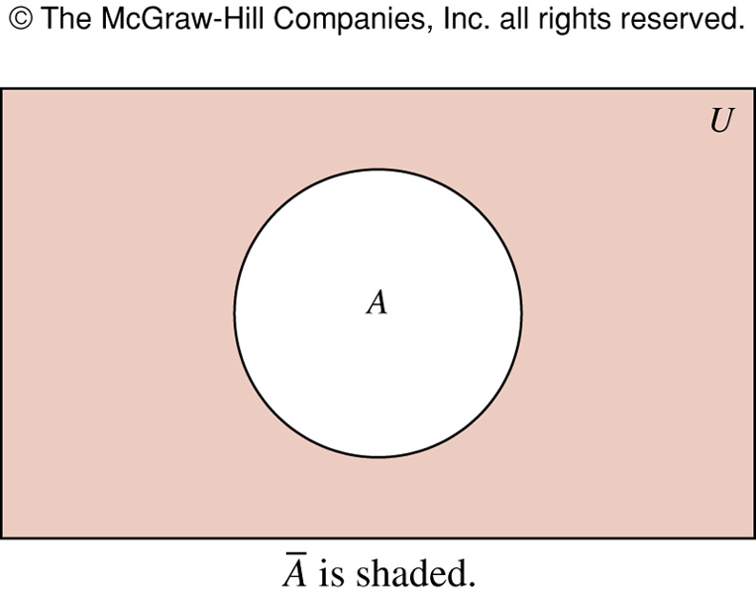
FIGURE 4 Venn Diagram for the Complement of the Set A
‾A = { x | x ∉ A }
‾A

Slide 15
Symmetric difference of Two Sets
Definition: The symmetric difference of two sets A and B, denoted by A ⊕ B, is the set of elements that belongs to A or to B, but not to both A and B.
A ⊕ B = The set containing those elements in exactly one of A and B.
A ⊕ B = { x | (x ∈ A ∧ x ∉ B) v (x ∈ B ∧ x ∉ A) }
= (A – B) U (B – A) ==> (proof on next slide)
Example: If A = { -3, 0, 1, 2} and B = { 1, 2, 3, 4 }, then
A ⊕ B = { -3, 0, 3, 4}
Alternate Solution: A – B = { -3, 0 } and B – A = { 3, 4 }. Therefore, (A - B) U (B - A) = { -3, 0, 3, 4 }

Slide 16
Symmetric difference of two Sets
Proof:
A ⊕ B = { x| (x ∈ A ∧ x ∉ B) v (x ∈ B ∧ x ∉ A)}
= { x | (x ∈ A − B) v (x ∈ B − A)}
= { x |x ∈ ((A − B) U (B − A))}
= (A − B) U (B − A)

Slide 17
Figure: Venn Diagram for The Symmetric Difference of two sets A and B, A ⊕ B
U
A
B

Slide 18
Set Identities
To prove set identities:
Show that each is a subset of the other
Show that A ⊆ B and that A ⊇ B
Using membership tables
Like truth tables
Use logical equivalences to prove equivalent set definitions

Slide 19
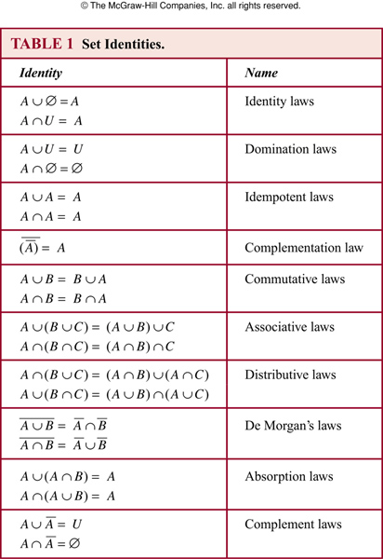

Slide 20
Set Identities
This table is gotten from the previous table(TABLE 6, page 24) of logical identities by rewriting as follows:
Disjunction “∨” becomes union “∪”
Conjunction “∧” becomes intersection “∩”
Negation “¬” becomes complementation “–”
False “F” becomes the empty set ∅
True “T” becomes the universal set U

Slide 21
Membership Table
Membership Table: A table displaying the membership of elements in sets.

Slide 22
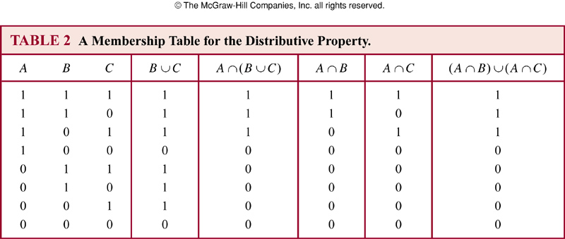
Set Identity : Using Membership Table

Slide 23
Set Identities via Venn Diagram
It’s often simpler to understand an identity by drawing a Venn Diagram.
For example De Morgan’s first law can be visualized as follows.

Slide 24
Visual De Morgan’s Law
A:
B:

Slide 25
Visual DeMorgan
A:
B:
A∪B :

Slide 26
Visual DeMorgan
A:
B:
A∪B :

Slide 27
Set Identities
Prove that using a membership table.
0 : x is not in the specified set
1 : otherwise
(A U B) = A ∩ B
A | B | A | B | A ∩ B | A U B | A U B
1 | 1 | 0 | 0 | 0 | 1 | 0
1 | 0 | 0 | 1 | 0 | 1 | 0
0 | 1 | 1 | 0 | 0 | 1 | 0
0 | 0 | 1 | 1 | 1 | 0 | 1

Slide 28
Set Identities
Prove that using set builder notation and logically equivalences
(A U B) = A ∩ B
(A U B) = {x | ¬ (x ∈ A v x ∈ B) }
= {x | ¬(x ∈ A) ∧ ¬(x ∈ B)}
= {x | (x ∈ A) ∧ (x ∈ B)}
= A ∩ B

Slide 29
Set Identities
Practice the following at home:
Example 11
Example 14

Slide 30
Generalized Unions and Intersections
Definition : The union of a collection of sets is the set containing those elements that are members of at least one set in the collection.
A₁∪ A₂ ∪ … ∪ A_{n} =
Definition: The intersection of a collection of sets is the set containing those elements that are members of all the sets in the collection.
A₁∩ A₂ ∩ … ∩ A_{n} =

Slide 31
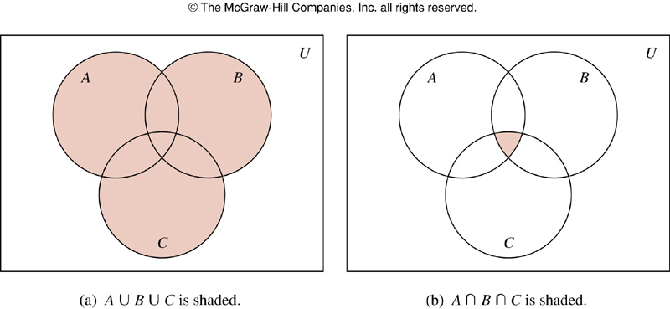
FIGURE 5 The Union and Intersection of A, B, and C

Slide 32
Examples: Union and Intersection of three sets
Example 15 : Let A = { 0, 2, 4, 6, 8}, B = {0, 1, 2, 3, 4}, and
C = { 0, 3, 6, 9}. What are A U B U C and A ∩ B ∩ C ?
Solution:
A U B U C = { 0, 1, 2, 3, 4, 6, 8, 9}
A ∩ B ∩ C = { 0 }
Q: Show the above sets in a Venn Diagram. Assume universal set U.

Slide 33
Computer Representation of Sets
There are various ways to represent sets using a computer.
One method is to store the elements of the set in an unordered fashion.
But time-consuming
We use a method for storing elements using an arbitrary ordering of the elements of the universal set(we assume that the universal set is finite).

Slide 34
Computer Representation of Sets
If we order the elements of our universe, we can represent sets by bit-strings. For example, consider the universe
U = {ant, beetle, cicada, dragonfly}
Order the elements alphabetically. Subsets of U are represented by bit-strings of length 4. Each bit in turn, tells us whether the corresponding element is contained in the set.
For example, {ant, dragonfly} is represented by the bit-string 1001
Question: What set is represented by 0111 ?

Slide 35
Computer Representation of Sets
Answer : 0111 represents {beetle, cicada, dragonfly}
Conveniently, under this representation the various set theoretic operations become the logical bit-string operators that we saw before.
For example, the symmetric difference of {beetle} with
{ant, beetle, dragonfly} is represented by:
0100
⊕ 1101
1001 = {ant, dragonfly}

Slide 36
Computer Representation of Sets
Example 18: Let U = { 1, 2, 3, 4, 5, 6, 7, 8, 9, 10 }
What bit string represents the subset of all odd integers in U?
What bit string represents the subset of all even integers in U?
What bit string represents the subset of integers not exceeding 5 in U?
Solution:
{ 1, 3, 5, 7, 9 } ==> 1010101010
{ 2, 4, 6, 8, 10} ==> 0101010101
{ 1, 2, 3, 4, 5} ==> 1111100000

Slide 37
Computer Representation of Sets
Using bit strings to represent sets, it is easy to find compliments of sets and unions, intersections, and difference of sets.
For example, to find the bit string for the complement of a set from the bit string for that set, we simply change each 1 to 0 and each 0 to 1.
Example 19 : What is the bit string for the complement of the set { 1, 3, 5, 7, 9}, where U = { 1, 2, 3, 4, 5, 6, 7, 8, 9, 10 }?
Solution: Try it out yourself!

Slide 38
Computer Representation of Sets
Solution of the Example 19:
The bit string for the set { 1, 3, 5, 7, 9} is 1010101010.
The bit string for the complement of this set is obtained by replacing 0s with 1s and vice versa.
This yields the string 0101010101 which corresponds to the set { 2, 4, 6, 8, 10 }

Slide 39
Practice @Home
Relevant odd-numbered exercises from your book
Exercises : 3, 15, 17, 19, 25, 27 , 51

